Slide 1
CBD Calla panel
Automatic assembly line
--- Point B-side heat dissipation paste Machine
Jan 23, 2026

Slide 2






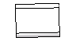
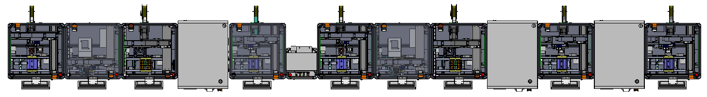

CBD Calla PCBA Assembly Line（New）
Line flow
unit：mm
900
900
800
840
900
600
900
900
800
840
900
840
900
Item | 1 | 2 | 3 | 4 | 5 | 6 | 7 | 8 | 9 | 4 | 11 | 12 | 13
Equipment | Stick B-side EMI Machine | Point B-side heat dissipation paste Machine | Stick B-side heat sink Machine（Robot） | Pressing machine | Stick B-side foam Machine*2 | Flip Over Machine | Stick T-side EMI Machine | Point T-side heat dissipation paste Machine | Stick T-side heat sink Machine（Robot） | Pressing machine | Stick FSS Machine | Pressing FSS machine | Stick T-side foam Machine*2
New /Old | old | old | old | Gs | old | Gs | old | old | old | Gs | new | Gs | old
CT(S) | 6 | 6 | 6 | 4 | 6 | 6 | 6 | 6 | 6 | 4 | 6 | 4 | 6
Feeding method | reel | Plastic bucket | reel | / | reel | reel | / | Plastic bucket | reel | / | reel | / | reel
Automation Assembly Line UPH ：500PCS/H
Automation Assembly Line Dimension ： L 11020mm * W 1500mm * H 1620mm (For reference, according to the actual)
Auto machine(new)
Auto machine(old)
Auto machine（Guest supply）

Slide 3


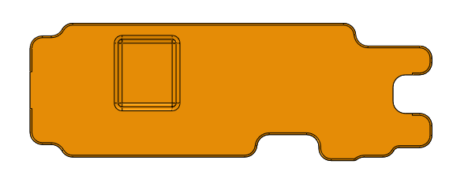


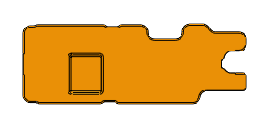

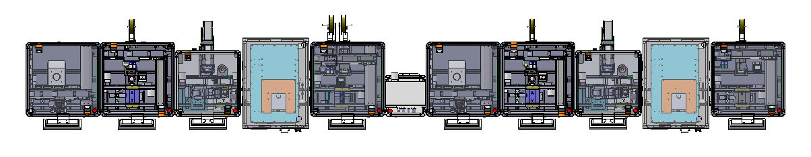
CBD Conny PCBA Assembly Line（Old）
Line flow
unit：mm
900
900
800
840
900
600
900
900
800
840
900
Item | 1 | 2 | 3 | 4 | 5 | 7 | 8 | 9 | 10 | 11 | 12
Equipment | Point B-side heat dissipation paste Machine | Stick B-side EMI Machine | Stick B-side heat sink Machine | Pressing machine | Stick B-side foam Machine*2 | Flip Over Machine | Point T-side heat dissipation paste Machine | Stick T-side EMI Machine | Stick T-side heat sink Machine | Pressing machine | Stick T-side foam Machine*1
New /Old | old | old | old | new | old | Gs | old | old | old | new | old
CT(S) | 4 | 5 | 6 | 3 | 6 |  | 6 | 5 | 6 | 3 | 6
Feeding method | Plastic bucket | reel | reel | / | reel | / | Plastic bucket | reel | reel | / | reel
Automation Assembly Line UPH ：500PCS/H
Automation Assembly Line Dimension ： L 9300mm * W 1500mm * H 1620mm (For reference, according to the actual)
Auto machine(new)
Auto machine(old)
Auto machine（Guest supply）

Slide 4
Contents
unit：mm
Item | Description | DRI
1 | Historical version | Wang hao
2 | Machine performance design | Wang hao
3 | Product Change | Wang hao
4 | Equipment Layout | Wang hao
5 | The key components | Wang hao
6 | Key Fixture Design | Wang hao
7 | Action flow design | Wang hao
8 | Timing diagram | Wang hao
3

Slide 5
1. Historical version
unit：mm
Version | Description | Date | DRI | Remark
V01 | Initial design version | 2026/01/23 | Wang hao
4

Slide 6
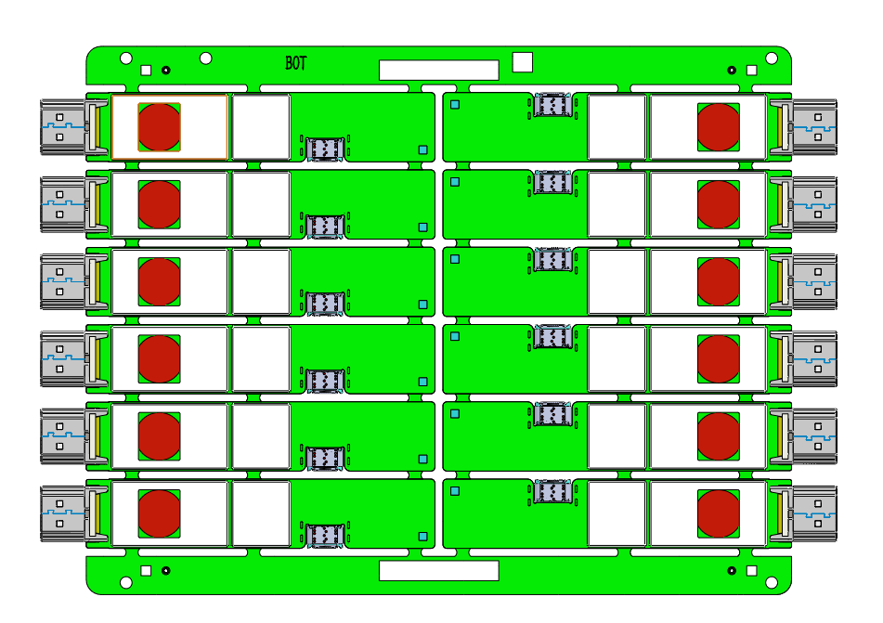
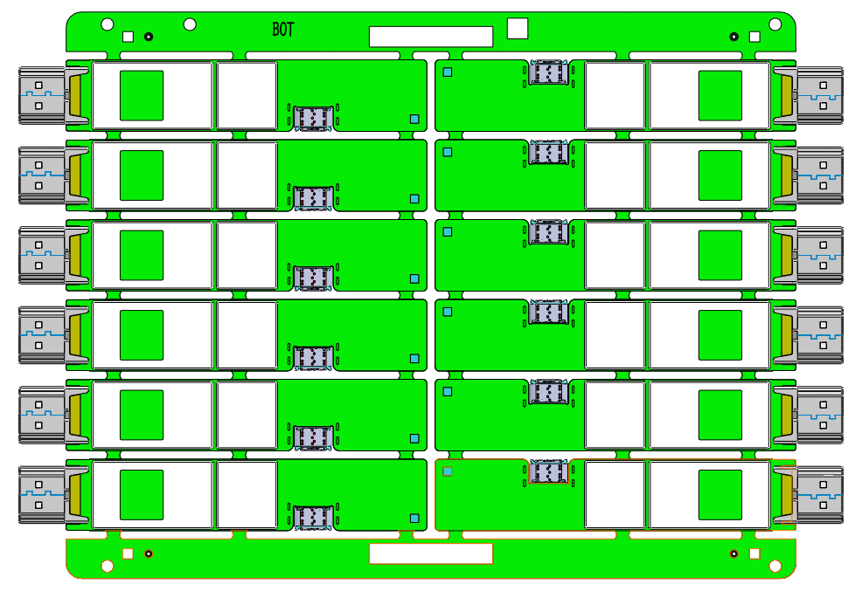
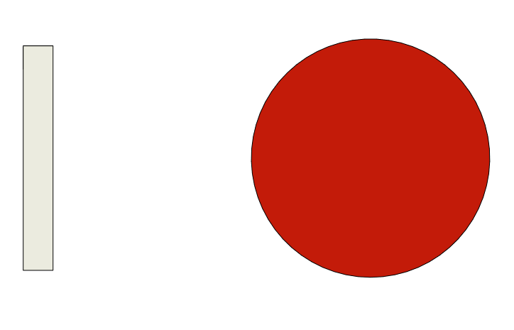
2. Machine Performance Design
Function：
unit：mm
PCBA board
Heat dissipation paste
Apply heat dissipation paste onto the BOT surface of the PCBA board
Purpose | Apply heat dissipation paste onto the BOT surface of the PCBA board
PCBA board | 137.6*199.8mm
Tool | TABLE Load transfer component，Dispensing valve，CCD，Electronic Balance，Actuator
Process | CCD calibration
Process requirements | Glue dispensing accuracy ± 3%
UPH requirements | 720PCS
5

Slide 7
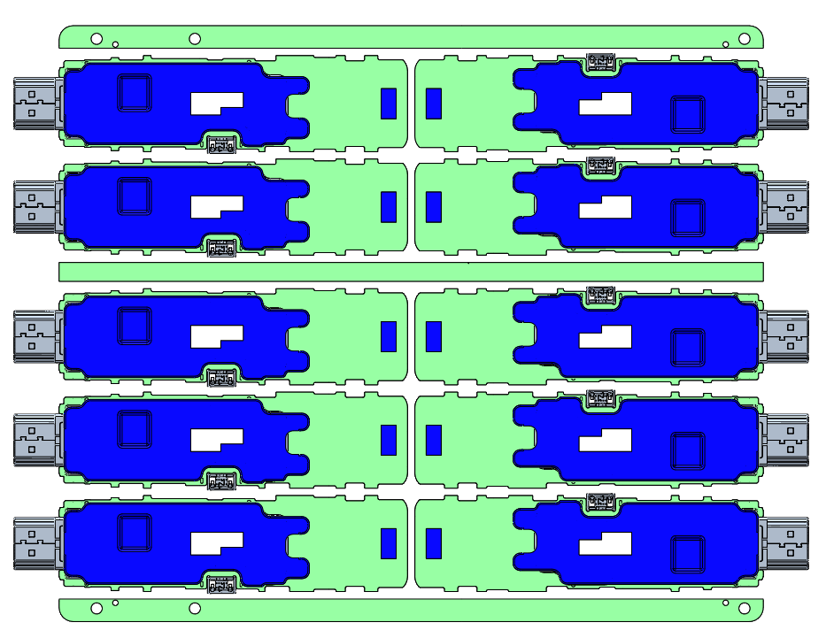
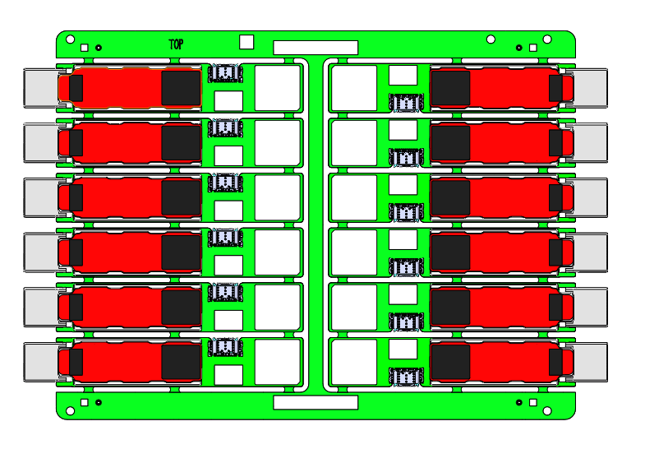
3.Product Change
unit：mm
PCBA：
Cony
Calla
Need to change the image from newst panel design Drw in calla DFM
137.6mm
159mm
187.8mm
184mm
6

Slide 8
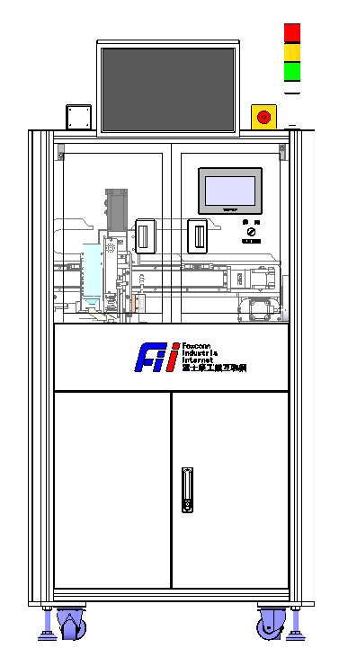
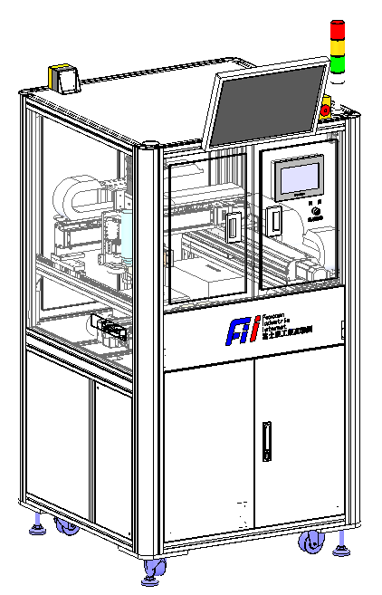
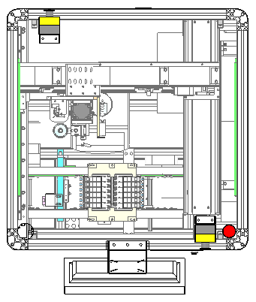
4. Equipment Layout
unit：mm
Tricolor lamp
1600mm
PC
Touch screen
positional accuracy | ±0.03mm
Alignment accuracy | ±0.15mm
Dispensing accuracy | ±3%
CT | 4.0s
UPH | 720PCS
900mm
900mm
7

Slide 9
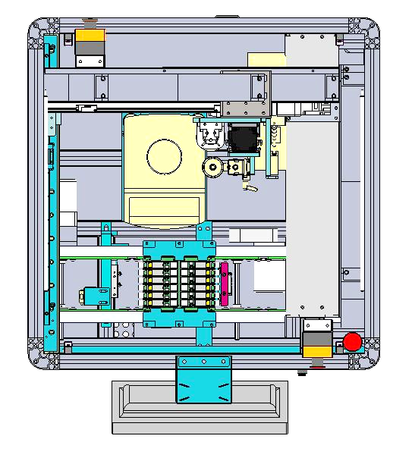
4. Equipment Layout
unit：mm
module | Process Flow
1 | Rangefinder
2 | Dispensing component
3 | X-axis transfer
4 | Y-axis transfer
5 | Code scanner
6 | Transport module
7 | Electronic Balance
3
5
2
7
1
4
进板
Carrier inflow
6
出板
Carrier outflow
8

Slide 10
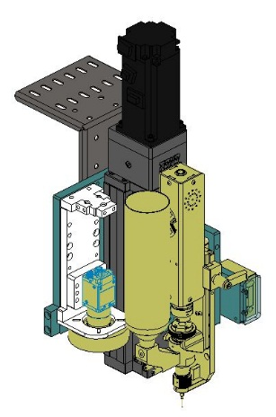
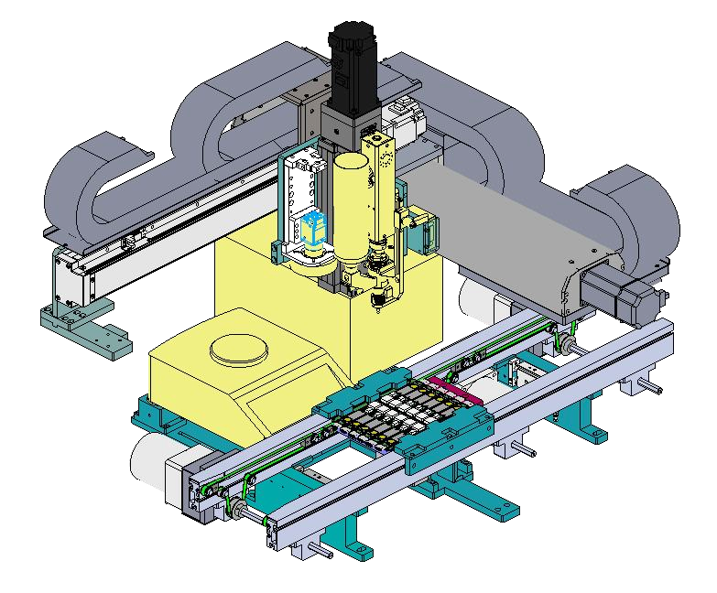
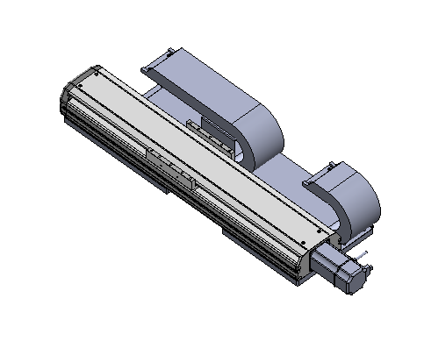
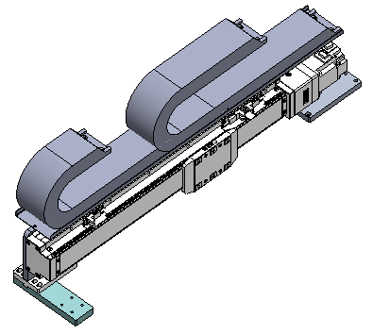
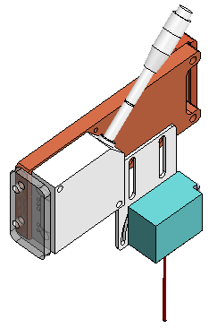
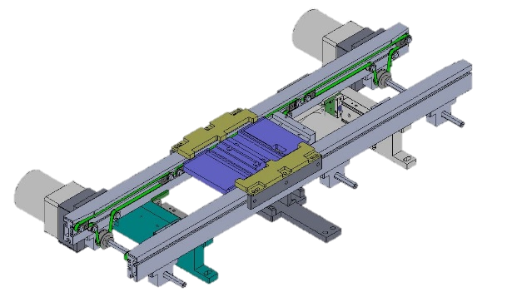
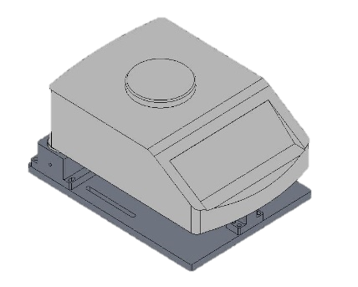
4. Equipment Layout
unit：mm
1
4
Coil feeder
Y-axis transfer
3
2
X-axis transfer
Code scanner & rangefinder
Electronic Balance
6
5
Transport module
9

Slide 11
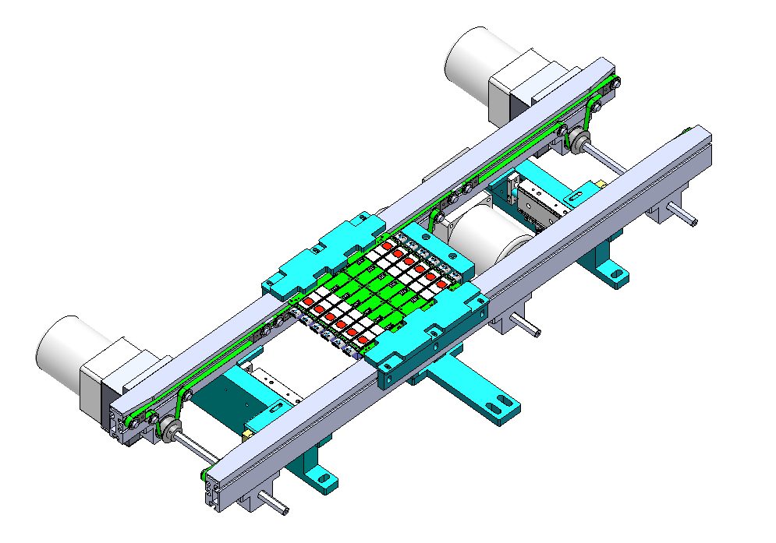
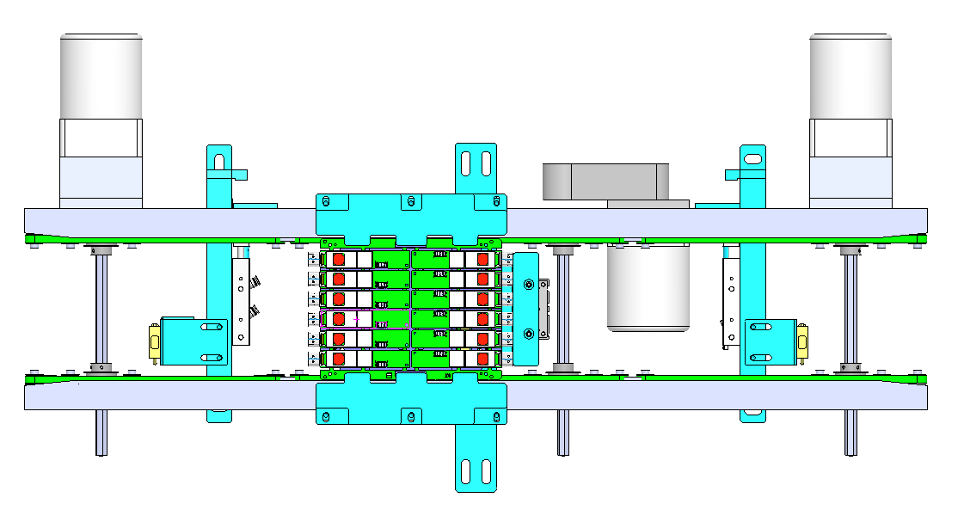
5. The key components
5.1 Feed conveyor line
Due to changes in the length
of the PCBA, need to
change the blocking block of
the blocking cylinder
PCBA blocking cylinder
PCBA in place deceleration sensor
Motor
138.6mm
PCBA lifting limit component
PCBA jacking cylinder
PCBA support board
Sensor CX-461A
Detect whether the PCBA drives into the conveyor line
Sensor CX-461A
Detect whether the PCBA drives into the conveyor line
PCBA board positioning process:
1.The PCBA board flows into the conveyor line, and the CX-461A senses that the conveyor line
slows down and blocks the PCBA board from the blocking cylinder.
2.The lifting cylinder is pushed out to position the PCBA board.
10

Slide 12
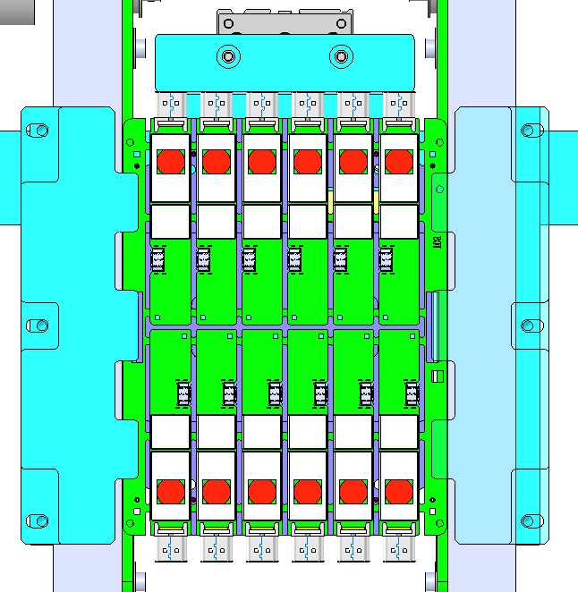
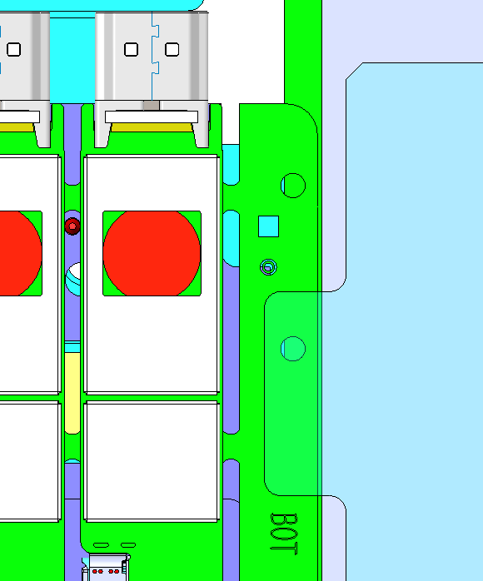
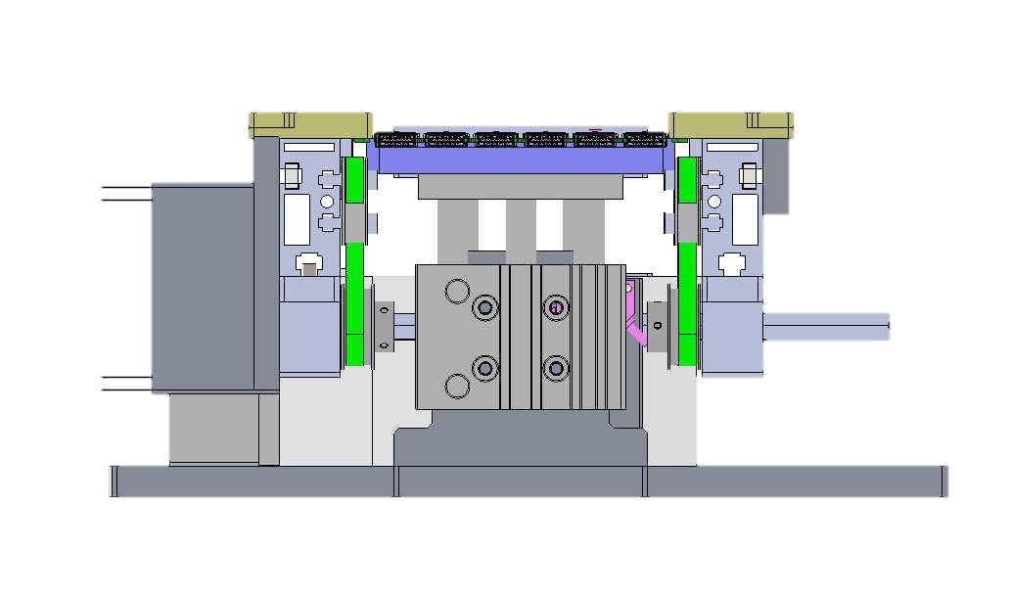
5. The key components
5.1 Feed conveyor line
unit：mm
The clamp block is in contact with the edge strip of the connecting plate 3.8mm
clamping position
The distance between the connecting plate and the edge of the conveyor line is 0.5mm
PCBA board clamping:
1. PCBA board arrives at the assembly position;
2, the block cylinder is blocked out3. At the same time, the support plate rises to support the PCBA board.
11

Slide 13
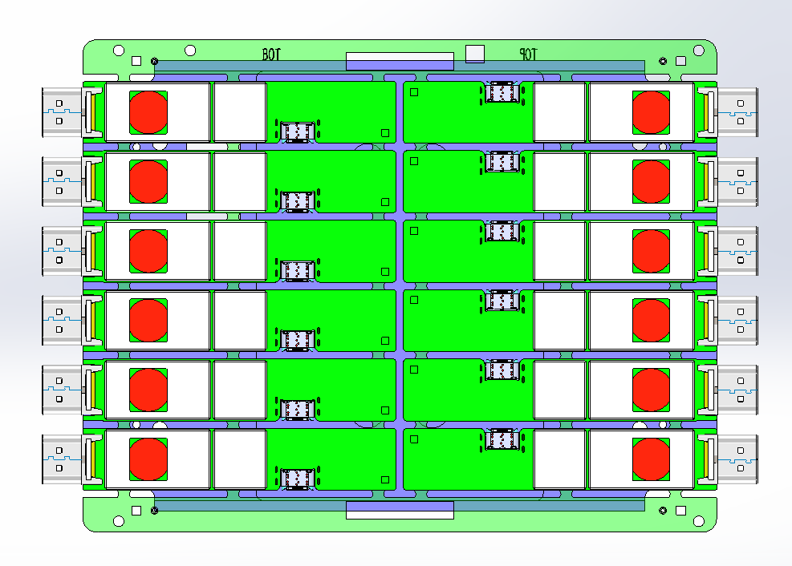
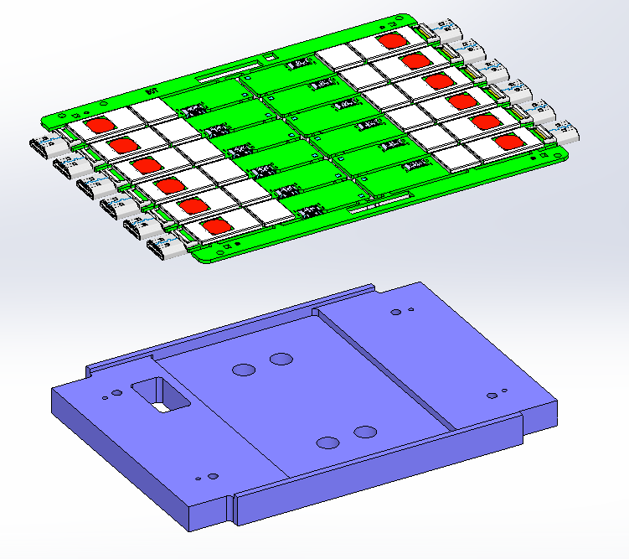
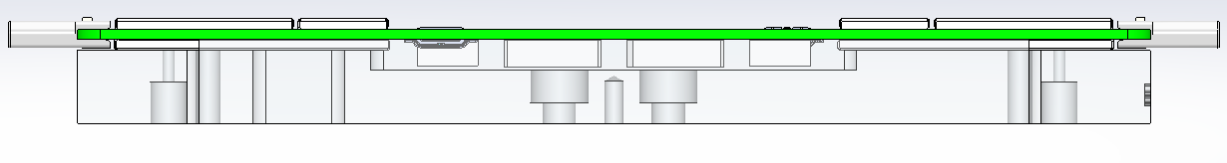
5. The key components
5.1 Feed conveyor line
unit：mm
5.5mm
B-side jacking plate(A6061)
The TPYE-C port is
5.5mm from the front
of the avoidance slot
12

Slide 14
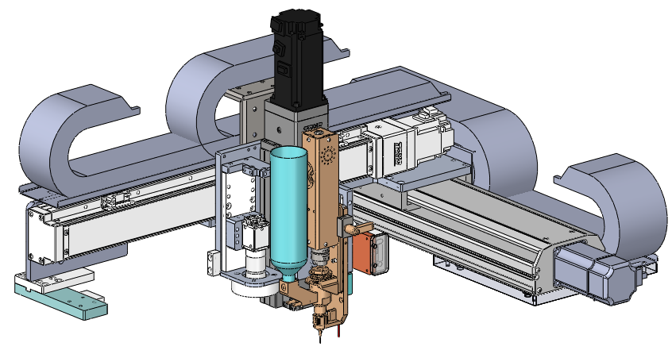
5. The key components
5.2 TABLE Load transfer component
unit：mm
Vacuum negative pressure gauge
X-axis transfer
Type | GTH8-L20-400-BC-S20-C4
Brand | TOYO
repeatability | ±0.005mm
Position accuracy | ±0.01mm
Travel distance | 250mm
Max speed | 1000mm/s
Work speed | 800mm/s
Maximum load | 18kg
Work load | 8Kg
X-axis slide table
Y-axis slide table
Upper CCD
Heat dissipation valve
Z-axis transfer
Type | GTH8-L10-50-BC-S40B-C4
Brand | TOYO
repeatability | ±0.005mm
Position accuracy | ±0.01mm
Travel distance | 250mm
Max speed | 1000mm/s
Work speed | 800mm/s
Maximum load | 18kg
Work load | 3kg
Y-axis transfer
Type | ETH14-L32-500-BC-S40-A2
Brand | TOYO
repeatability | ±0.005mm
Position accuracy | ±0.01mm
Travel distance | 500mm
Max speed | 1600mm/s
Work speed | 1280mm/s
Maximum load | 15kg
Work load | 10.5kg
Main structure: sliding table, Heat dissipation valve, CCD, perambulator
13

Slide 15
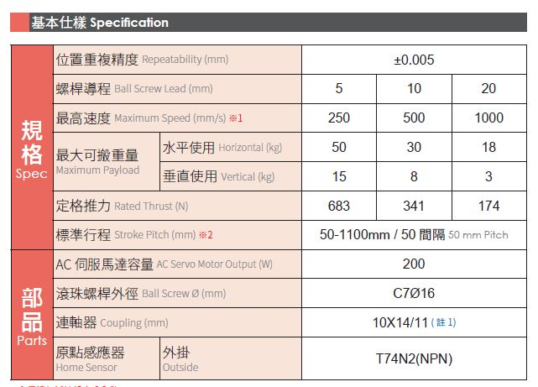
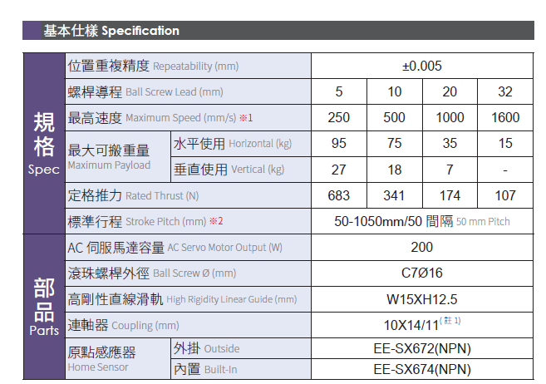
5. The key components
5.2 TABLE Load transfer component
unit：mm
X -axis GTH8-L20-400-BC-S20-C4
Y-axis ETH14-L32-500-BC-S40-A2
Z -axis GTH8-L10-50-BC-S40B-C4
14

Slide 16
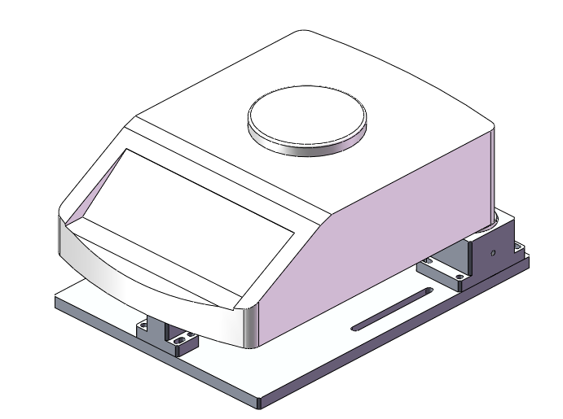
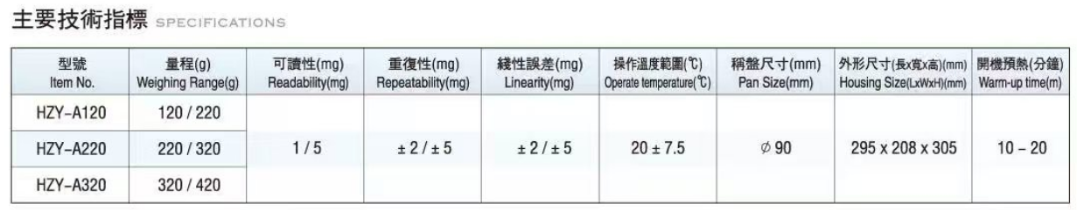
5. The key components
5.3 Electronic Balance
unit：mm
Purpose:
1. Used for manual inspection of adhesive quantity2. Used for automatic weighing during equipment operation (set weighing time, automatically weigh at regular intervals to ensure that the amount of glue dispensed is within the dispensing weight specified in SOP)
Electronic balance model
Note: It is recommended to manually wipe and clean the electronic balance tray once per shift with a dust-free cloth.
Electronic balance parameters
15

Slide 17
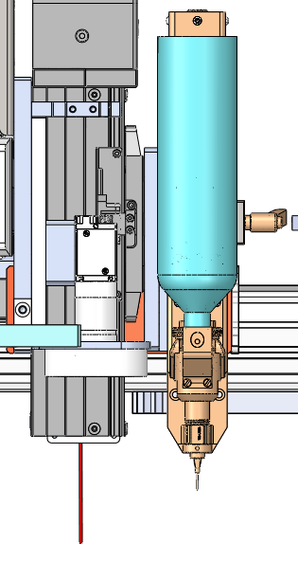
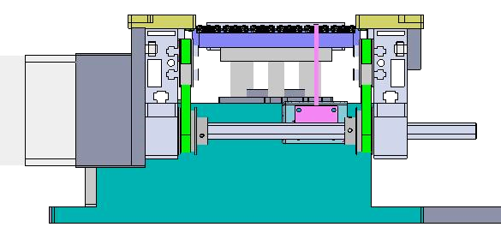
5. The key components
5.4 Upper CCD
unit：mm
layout：
Hardware name | Model | quantity
camera | MV-GES200GC-T-CL | 1
lens | RICOH/FL-CC1614-2M | 1
Close up adaptor | 无 | 0
optical source | 光源/華周/HRS-70W60 | 1
optical source controller | DKZ2-24V-2-AC | 1
camera：FM-GE500-22M
lens：FL-CC1214A-2M
30±10mm
Camera mounting orientation | back to the human machine ↑
The distance between the camera surface → the product | 160±10 mm
The distance between the camera surface → optical source | 30±10mm
visual field | 66mm*51mm
Image pixel size | 1600*1200
Camera single-pixel accuracy | 0.04
optical source：HRS-70R60
160±10mm
PCBA

Slide 18
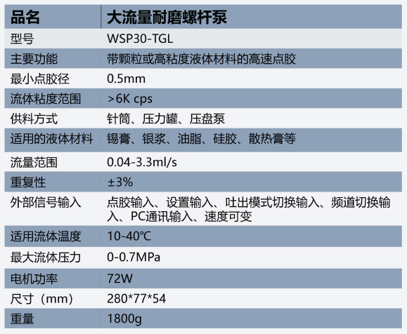
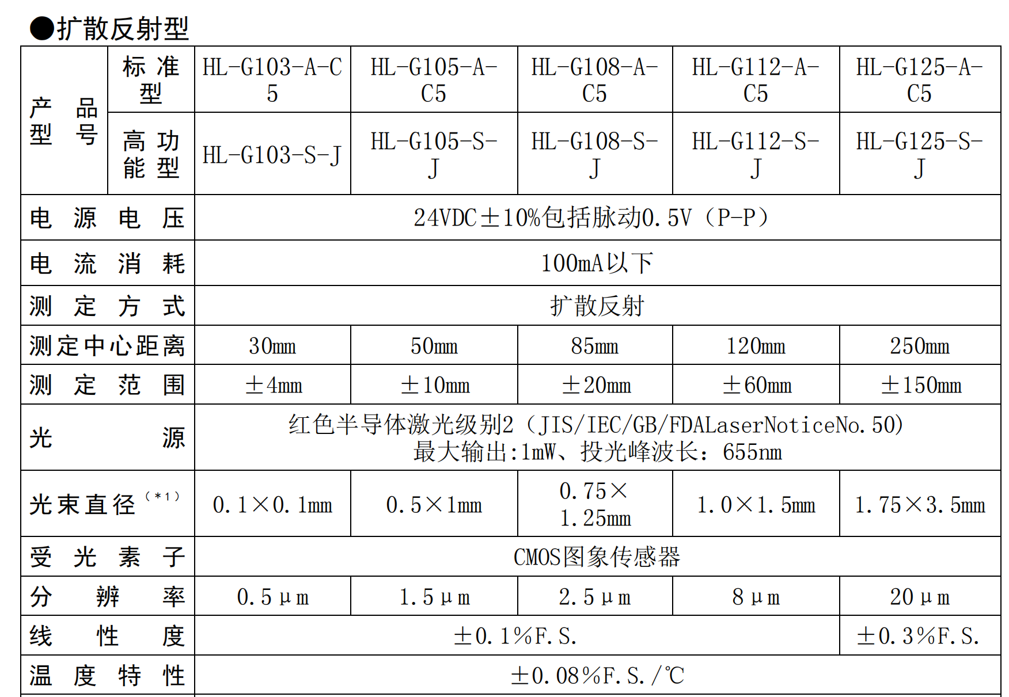
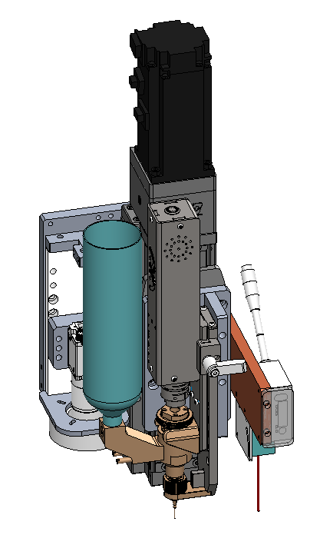
6. Key tool design
6.1Glue dispensing components
unit：mm
Rubber bucket
range finder
Dispensing valve
Glue dispensing head
(diameter 3.4)
17

Slide 19
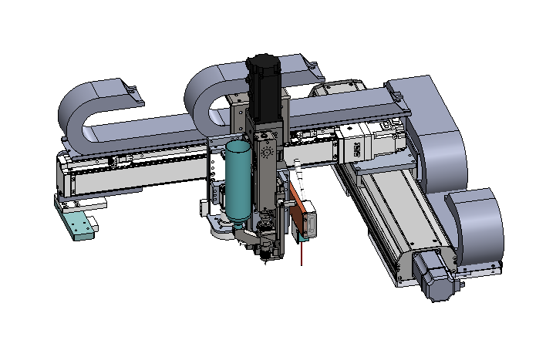
6. Key tool design
6.1Glue dispensing components
unit：mm
X-axis module accuracy | ±0.01
Y-axis module accuracy | ±0.01
Z-axis module accuracy | ±0.01
CCD recognition accuracy | ±0.12
Z-Servo motor
X-Servo motor
Positioning accuracy = X-axis module accuracy + Y-axis module accuracy +
Z-axis module accuracy：± (0.01+0.01+0.01) =±0.03mm；
Mounting accuracy=positioning accuracy + CCD recognition accuracy :
± (0.03+0.12)=0.15mm.
Y-Servo motor
18

Slide 20
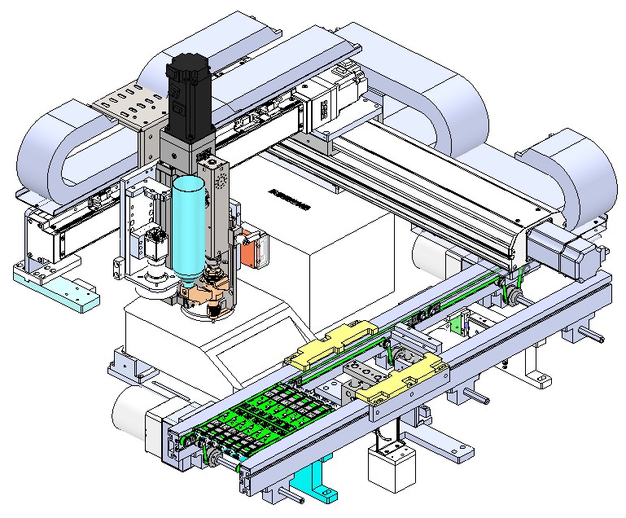
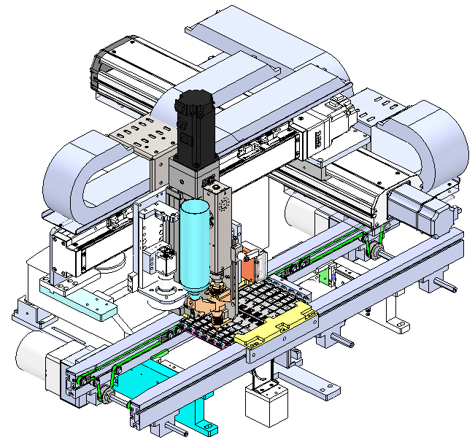
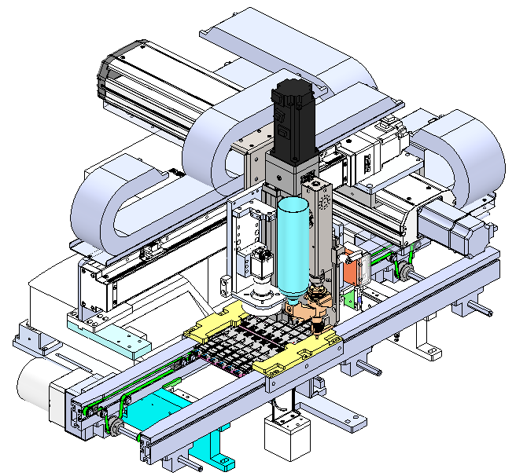
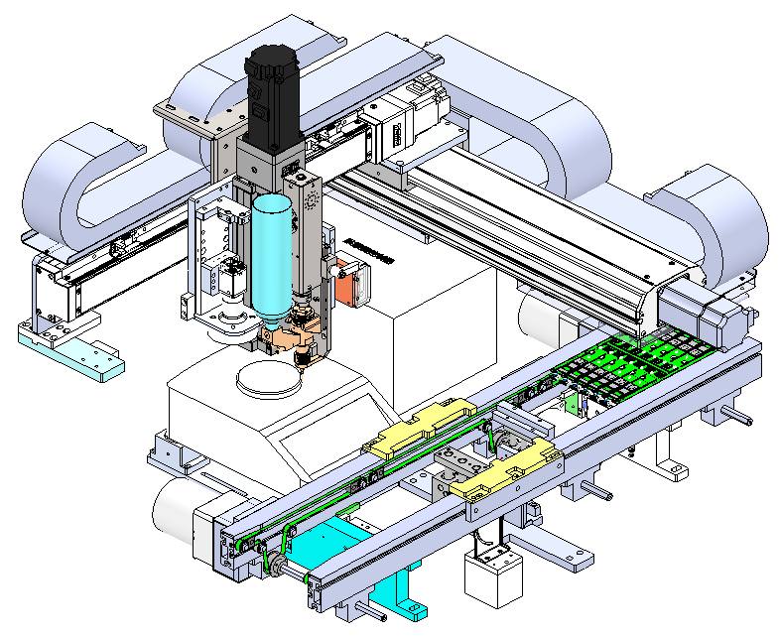
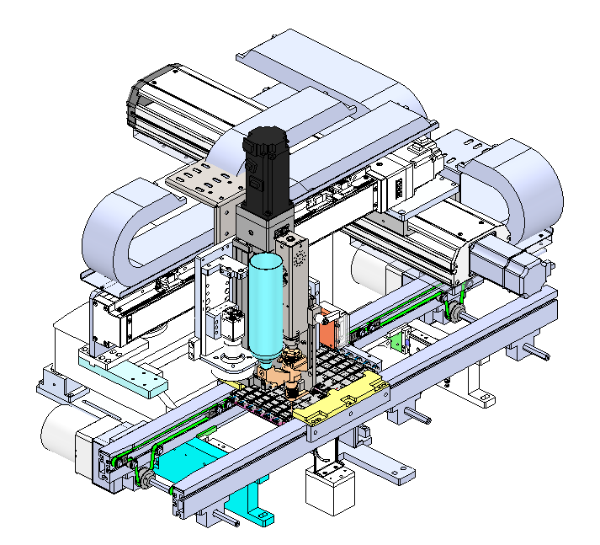
7. Action process design
unit：mm
Step1: The PCBA board of the front conveyor line flows in, blocking the cylinder from rising, and the sensor responds in place, and the jacking cylinder rises and clamps the PCBA continuous wrench
Step 2: The slide moves to the measuring point to start measuring, and after measuring, the scanner scans the QR code
Step 3: Use CCD to identify and locate the Mark points on PCBA
Step 6: PCBA flows out of the equipment and enters the next process
Step 5: Glue dispensing is completed, the camera moves to the glue point to identify the glue dispensing area and upload it to Kazan
Step 4: Move the dispensing head to the dispensing area for dispensing
19

Slide 21
8. Timing diagram
unit：mm
Automatic heating paste 0.5s/grid
產品入工作區 Product entering the workspace | 輸送線運轉時間1.5s Conveyor line running time 1.5s | 2
 | 產品定位 0.5s Product positioning 0.5s
測距&拍照&掃碼 Distance measurement, photography, and scanning | 滑台移動至測距點測距 1.5s The sliding table moves to the distance measuring point for 1.5 seconds |  |  |  |  | 4
 | Mark點拍照 1.5s Mark point photography for 1.5 seconds
 | 掃碼1s Scan the code for 1 second
點膠流程 Glue dispensing process | 滑臺移動到點膠點 0.5s Slide table moves to adhesive point for 0.5s |  |  |  |  |  |  |  |  |  |  |  |  | 12.5
 | 點膠（1-12號）13s Glue dispensing (1-12) for 13 seconds
識別面積&上傳卡站Identify Area & Upload Kazan | 相機移動到點膠點 1s Camera moves to the adhesive point for 1 second |  |  |  |  |  |  |  |  |  |  |  |  |  |  |  |  |  |  |  |  |  |  |  |  |  |  |  |  |  |  |  |  |  |  |  |  |  |  |  | 28
 | 識別面積（1-12號）9s Identification area (1-12) 9s
 | 上傳Kazan（5s） Upload Kazan (5s)
產品流出 Product outflow | 產品定位取消 0.5s Product positioning canceled in 0.5s |  |  |  |  |  |  |  |  |  |  |  |  |  |  |  |  |  |  |  |  |  |  |  |  |  |  |  |  |  |  |  |  |  |  |  |  |  |  |  |  |  |  |  |  |  |  |  |  |  |  |  |  |  |  |  |  |  |  |  |  |  |  |  |  |  |  |  |  |  |  |  |  |  |  |  |  |  |  |  |  |  |  |  |  |  |  |  |  |  |  |  |  |  | 1.5
 | 產品流入后buffer 1s Buffer for 1 second after the product flows in
 |  | 1 | 2 | 3 | 4 | 5 | 6 | 7 | 8 | 9 | 10 | 11 | 12 | 13 | 14 | 15 | 16 | 17 | 18 | 19 | 20 | 21 | 22 | 23 | 24 | 25 | 26 | 27 | 28 | 29 | 30 | 31 | 32 | 33 | 34 | 35 | 36 | 37 | 38 | 39 | 40 | 41 | 42 | 43 | 44 | 45 | 46 | 47 | 48 | 49 | 50 | 51 | 52 | 53 | 54 | 55 | 56 | 57 | 58 | 59 | 60 | 61 | 62 | 63 | 64 | 65 | 66 | 67 | 68 | 69 | 70 | 71 | 72 | 73 | 74 | 75 | 76 | 77 | 78 | 79 | 80 | 81 | 82 | 83 | 84 | 85 | 86 | 87 | 88 | 89 | 90 | 91 | 92 | 93 | 94 | 95 | 96
Cycle time/s | 48/12=4.0S | UPH: 3600/4.0*0.8=720
UPH≈3600/4.0*0.8=720
Note：80% is estimated OEE, only for UPH calculation. not real product data
20

Slide 22
Thank you
21

